Slide 1
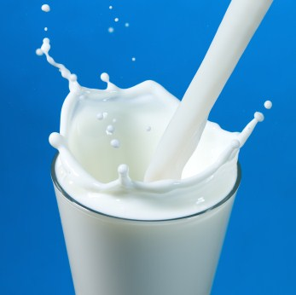
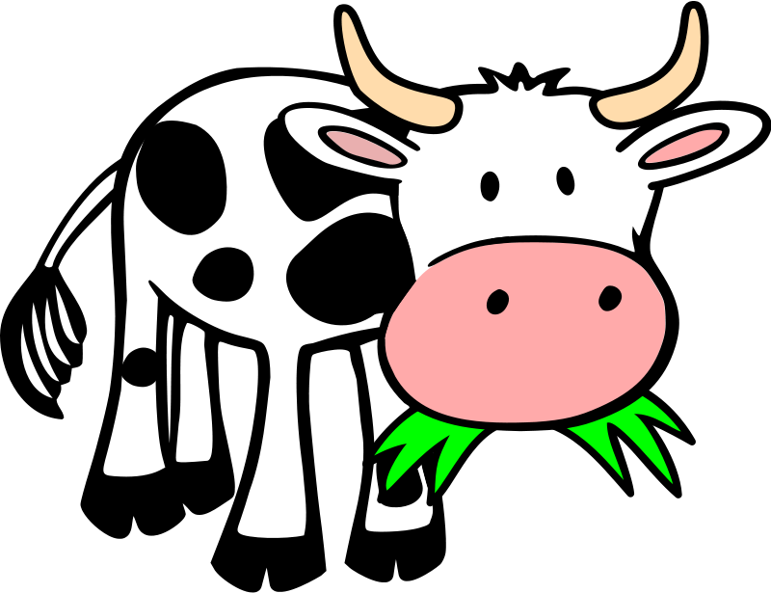
THE BIOCHEMISTRY OF MILK
CHAPTER 23
MOLLY, NICOLE, BRE

Slide 2
OBJECTIVES
VOCABULARY
Identify the components of milk and describe how they are dispersed in milk
Explain what happens when milk protein is coagulated
Describe how milk is processed and the effects of pasteurizing homogenizing and fortifying milk
Distinguish the characteristics of various milk products
Describe how cultured milk products are produced
Explain how milk and milk products should be stored
Relate certain factors to creams ability to foam
Describe reactions that may occur when milk is heated
Carrageenin
Casein
Cream
Creaming
Culture
Curds
Fortification
Incubation period
Inoculation
Lactose intolerant
Micelles
Milk solids
Precipitate
Shelf life
Whey

Slide 3
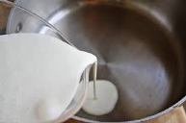
Complex Nature of Milk
Vital to Health
Versatile for cooking
A Solution
A colloidal dispersion
An emulsion

Slide 4
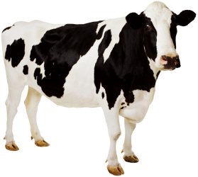
COMPOSITION OF MILK
Contains all major nutrients
Water – 87%
Protein - 3.5%
Fat - 3.5%
Carbohydrates - 5%
Vitamins and Minerals

Slide 5
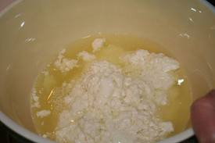
PROTEIN
Milk contains Two Main Proteins
Casein
80% of milk protein
Micelles: cluster of molecules
found in colloidal dispersions
Make milk white
Curds
Casein clumps that separate from the liquid
Whey
20% milk protein
Protein found in liquid that remains after fat and casein have been removed from milk

Slide 6
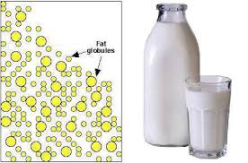
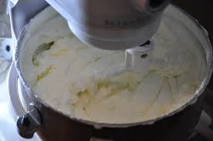
FAT
Emulsion
Small globules of lipids are dispersed throughout water
Creaming
Fat droplets come together in clusters that rise and float to top of milk
Cream
Milk that is extra rich in emulsified fat droplets

Slide 7
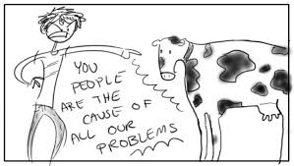
CARBOHYDRATE
Lactose or milk sugar is the main carbohydrate
Lactose intolerance
Inability to digest milk due to the absence of the lactase enzyme in intestines

Slide 8
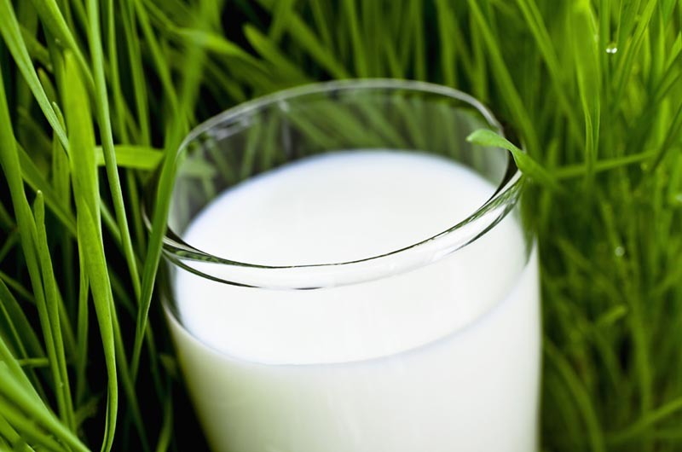
MINERALS AND VITAMINS
Natural salts
Prevent milk from curdling
Trace elements in milk;
Cobalt
Copper
Iodine
Iron
Magnesium
Nickel
Molybdenum
Vitamins in milk;
Riboflavin
Thiamin
Niacim
Vitamin A

Slide 9
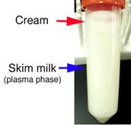
Processing Milk
Pasteurization – heat treated to kill harmful bacteria
Homogenization - process used to eliminate creaming
Fortification – adding nutrients to food, in milk vitamin D is added
http://video.nationalgeographic.com/video/science/weird-science-sci/idkt-milking-cow/

Slide 10
Types of Milk Products
Fluid Milk – classified by fat content (skim, 1%, 2% and whole)
Ultrahigh-Temperature Milk (UHT) – special processing, can be stored without refrigeration up to 3 months
Concentrated Milk (Evaporated Milk) – 60% of water is evaporated
Cream – classified according to fat content (half & half, light whipping cream and heavy whipping cream)
Dry Milk – water is removed leaving dry solids

Slide 11
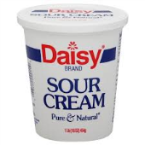
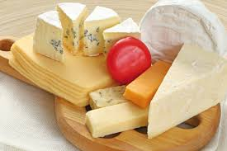
Cultured Milk Products
Culture – controlled bacterial population that is added to milk
Inoculation – starter is added to the milk to start the growth of bacteria
Incubation period – time bacteria has to grow and ferment the milk
Buttermilk, Sour Cream, Yogurt and Cheese

Slide 12
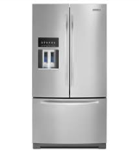
Storing Milk and Milk Products
Correctly storing milk and milk products helps maintain its quality and safety.
Retains quality for 1 to 3 weeks when properly stored.
Milk containers should be not transparent, sensitive to light.
Nonfat dry milk should be stored at room temperature in packaging that keeps moisture out.
An unrefrigerated product, processed cheese can be stored at room temperature until opened then should be refrigerated.
Wrap cheese tightly to prevent it from drying out.

Slide 13
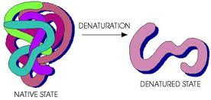
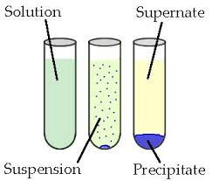
Cooking with Milk and Milk Products
Making Foam – gas bubbles trapped in a liquid
Factors affect the ability of cream to form a foamy topping
Fat Content – higher the fat content, the better the foam
Temperature – Cold temperatures increase the viscosity of the cream
Amount – whipping small amounts gives better results
Sugar content – adding sugar decreases both volume and stiffness
Heating Milk – milk is sensitive and highly reactive to heat
Heat denatures and coagulates the whey protein of fresh milk causing them to precipitate.
Precipitate – to cause a solid substance to
separate from a solution

Slide 14
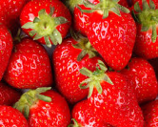
Cooking with Milk and Milk Products
Enzyme Action
When preparing desserts it is critical to maintain temperatures between 15°c. and 60°c. for enzyme action to occur.
Acids
High acid levels in fruit curdles milk, (example: in cereal)
The protein casein precipitate out when the pH of milk drops to 4.6.
Vegetables vary in how they cause milk to curdle.

Slide 15
